Slide 1
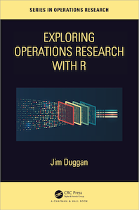
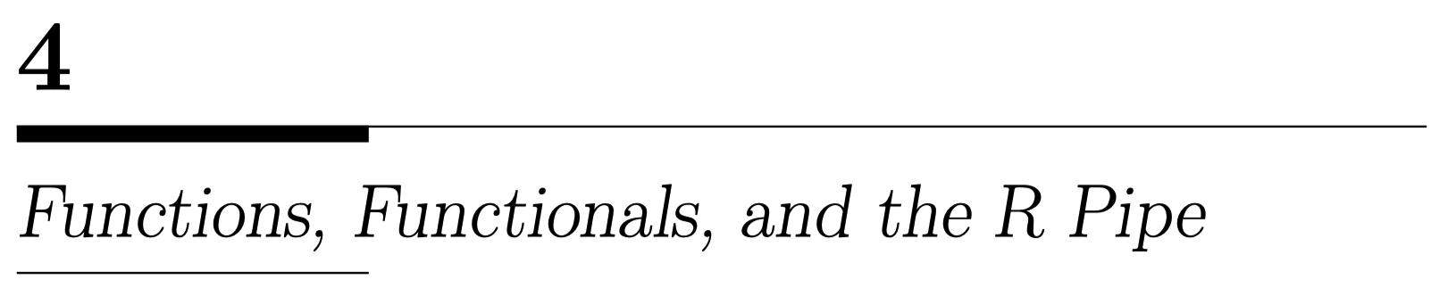

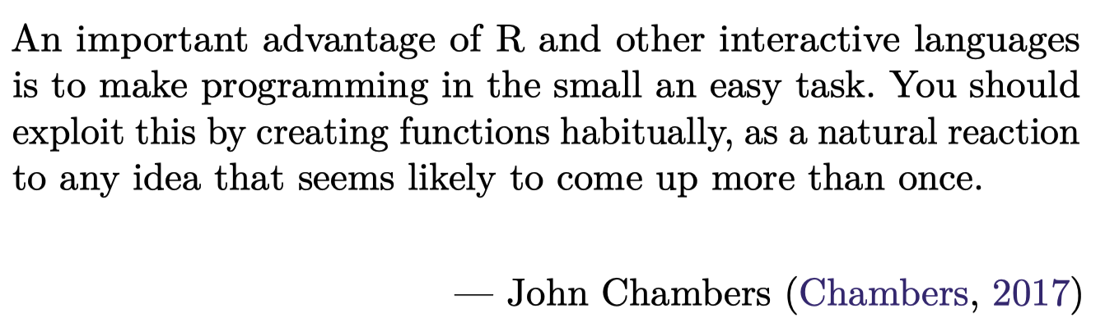
https://github.com/JimDuggan/explore_or

Slide 2
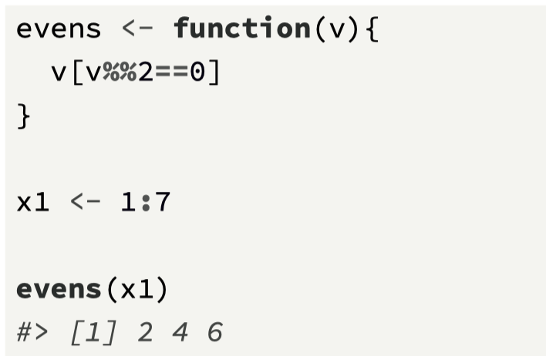
Functions
Functions are a fundamental building block of R. A function can be defined as a group of instructions that: takes input, uses the input to compute other values, and returns a result (Matloff, 2011).
The general form of a function in R is: function (arguments) expression, where:
arguments provides the arguments (inputs) to a function, and are separated by commas,
expression is any legal R expression contained within the function body, and is usually enclosed in curly braces (when there is more than one expression),
the last evaluated expression is returned by the function, although the function return() can be also used to return values
Functions are objects, and are usually assigned to a variable using <-

Slide 3
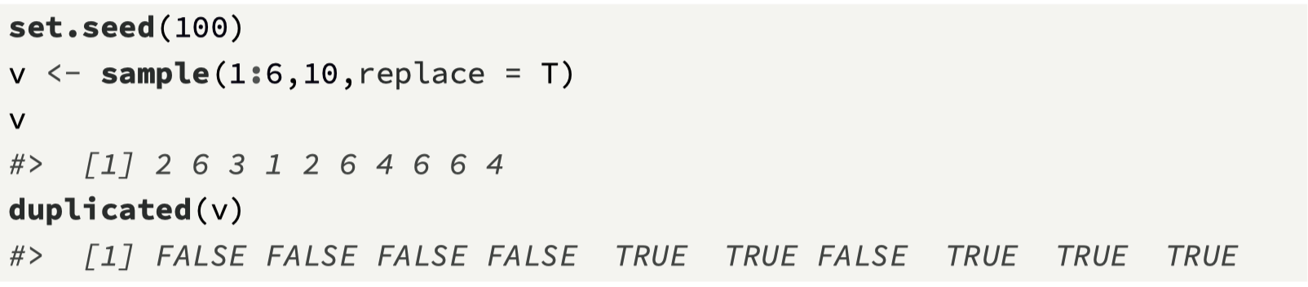
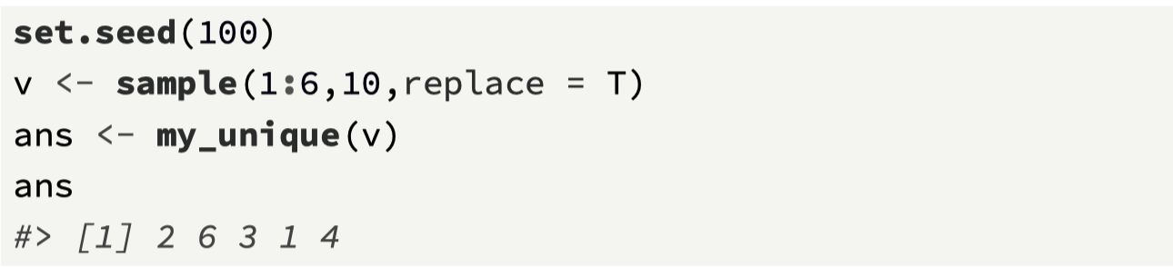
Removing duplicates
Our second function takes an approach of building on the work of R developers, and it uses an existing base R function to create a new one.
This function will take in a vector of random numbers, and remove any duplicates.
To remove the duplicates, we will make use of the R function duplicated(), which returns a logical vector that contains TRUE if a value is duplicated.

Slide 4
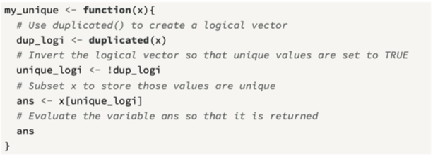
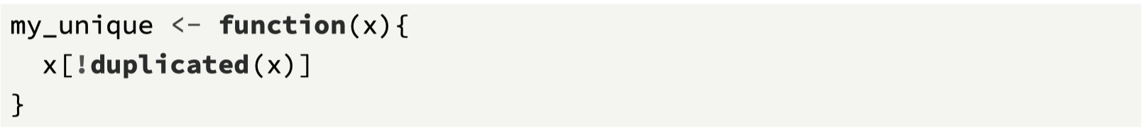
my_unique() function

Slide 5
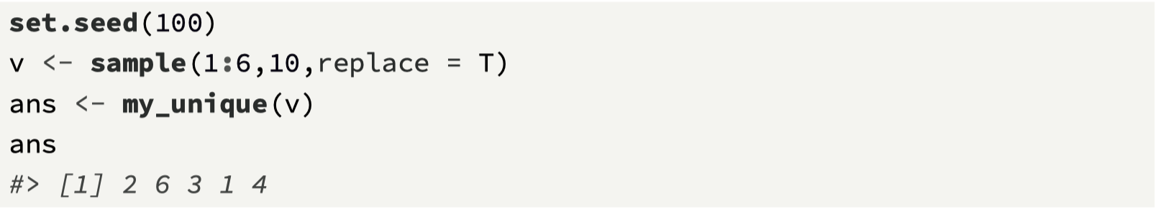
Writing functions in source files
It is also useful to write the function into a source file; let’s assume the file is called my_functions.R
To load the function into R, call the source function (this is easy to do within RStudio by clicking the “Source” button).
The function is then loaded into the workspace, and its existence can be confirmed by calling the ls() function, which returns a vector of character strings giving the names of the objects in the specified environment.

Slide 6
Challenge 4.1
Write a function throw_dice(n, seed) that will simulate the throw of two dice and return a vector containing all the results. It takes two arguments:
The number of times to throw the two dice (n)
The random number generate seed value

Slide 7
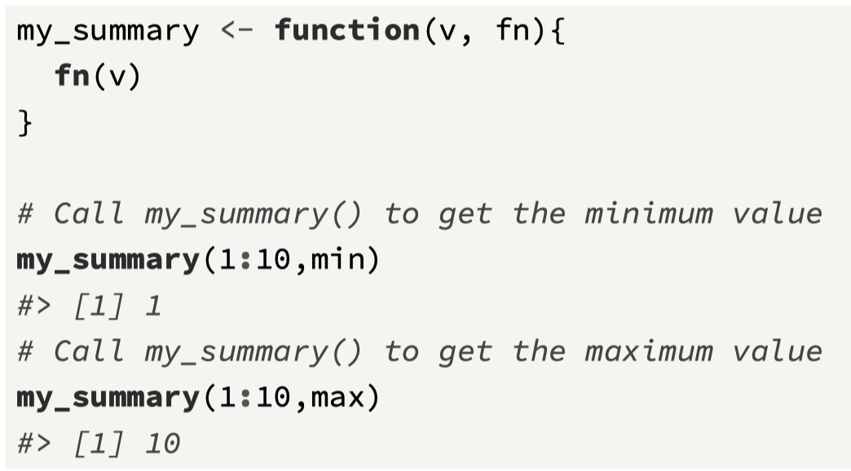
Functionals
Interestingly in R, functions are objects, so they can be passed to functions as arguments
Functionals are functions that accept functions as arguments
The function my_summmary(), takes a vector, and a function (e.g., min() or max()), and then returns the result of whatever function is sent in.

Slide 8
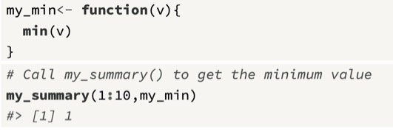
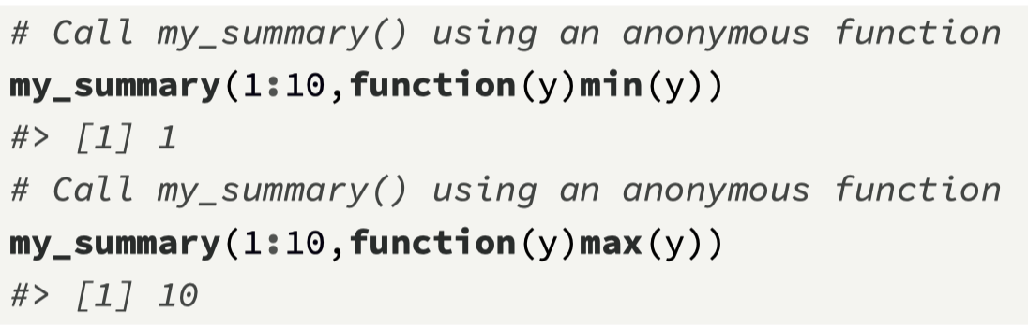
Your own functions and anonymous functions
An anonymous function is not assigned to a variable but can be embedded as an argument to a functional

Slide 9
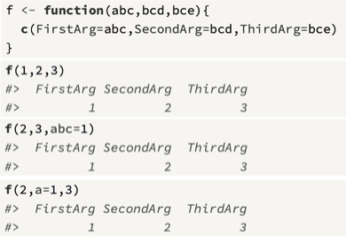
Passing arguments to functions
Each function in R is defined with a set of formal arguments that have a fixed positional order, and often that is the way arguments are then passed into functions (e.g., by position)
However, arguments can also be passed in by complete name or partial name, and arguments can have default values.

Slide 10
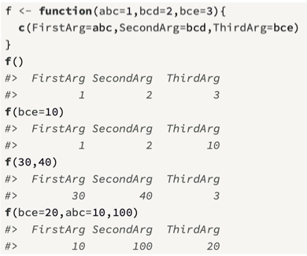
Default values for arguments
An important feature with defining arguments is that they can be allocated default values, which provides flexibility in that not all the arguments need to be called each time the function is invoked.
We can modify the function f so that each argument has an arbitrary default value.
Advice for passing arguments to functions (Wickham 2019), for example:
to focus on positional mapping for the first one or two arguments,
to avoid positional mapping for arguments that are not used too often, and
unnamed arguments should come before named arguments

Slide 11
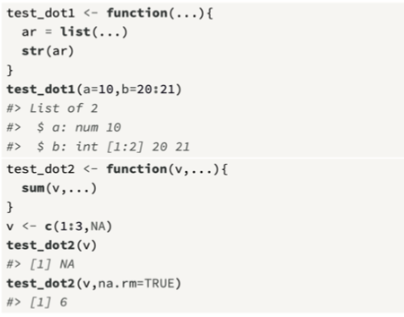
The … argument
This will match any arguments not otherwise matched, and this can be easily forwarded to other functions, or also explored, by converting to a list in order to examine the arguments passed.
Here is an example of how it can be used to pass any number of arguments to a function, and how the function can access these arguments.
It is often used to relay addition arguments to another function

Slide 12
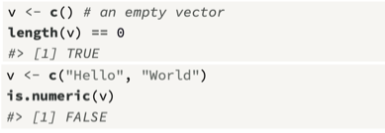
Error checking in functions
While functions are invaluable as small units of useful code, they must also be robust.
When an error is encountered, it should be dealt with.
From a programming perspective, a decision needs to be made as to whether an error condition requires that the program be halted, or whether an error generates information that can be relayed to the user.
Here we assume that the program must stop when an error is encountered. To do this, the R function stop() is called.
Here, we return to our first example for extracting even values from a vector.
For this case, we need to think about how we intend the function to be called; for example, what should happen if the input vector:
Is empty?
Is not an atomic vector?
Is not numeric?

Slide 13
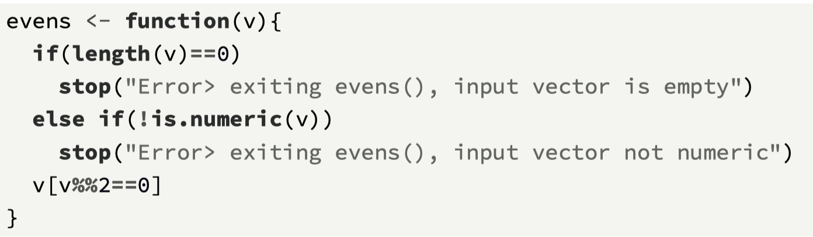
Fail fast…
Therefore, these two functions can be used to initially check the input values, and “fail fast” if necessary.
We add this checking logic to the function’s opening lines.

Slide 14
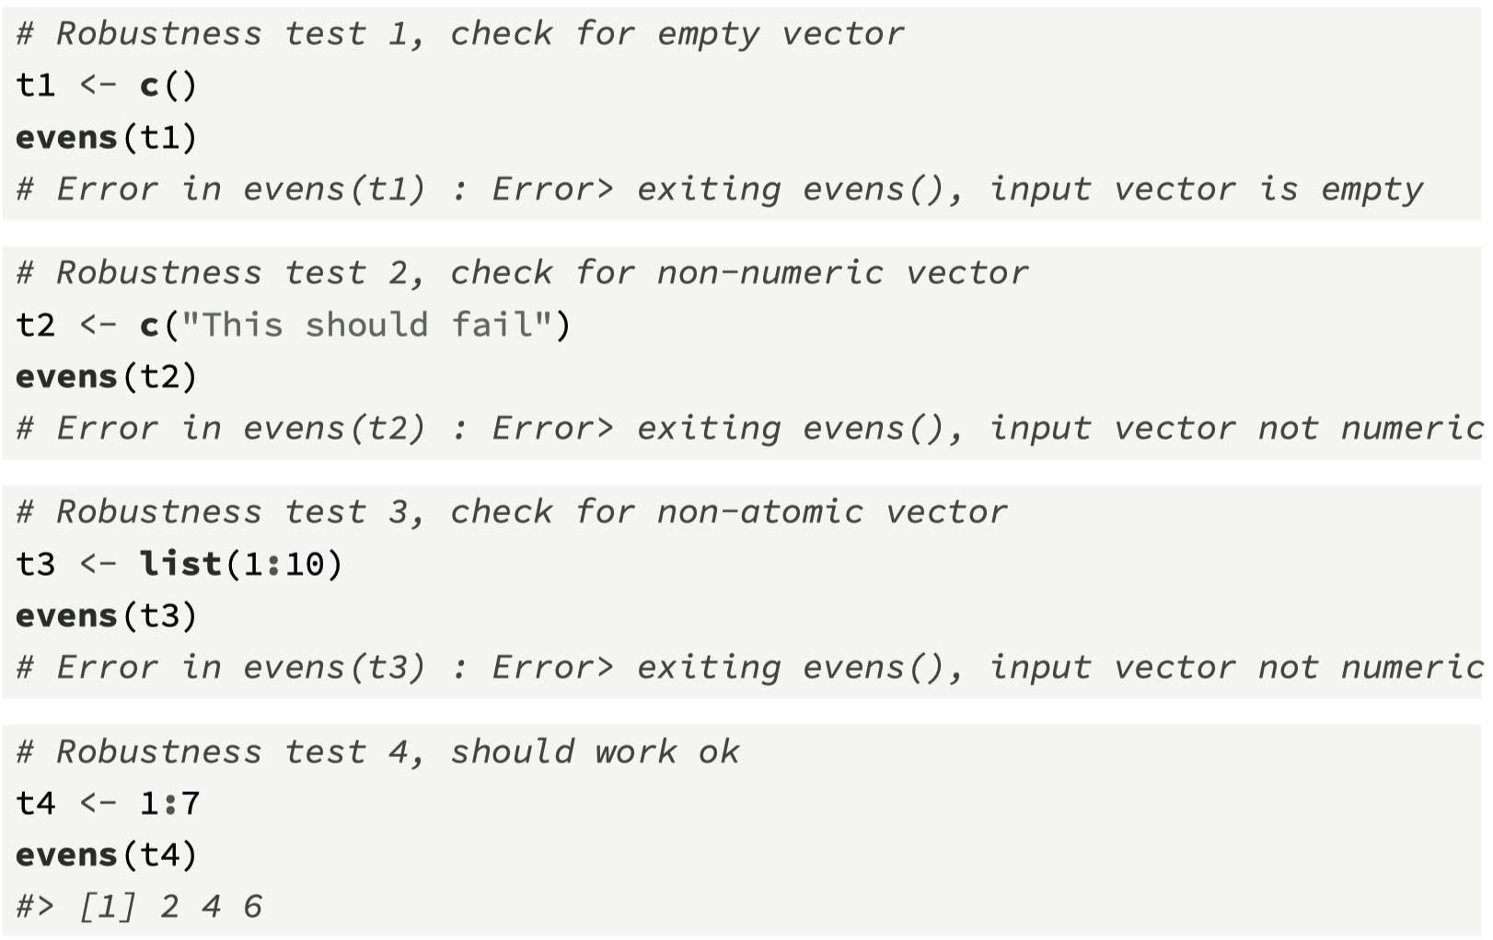
Robustness Checks…

Slide 15
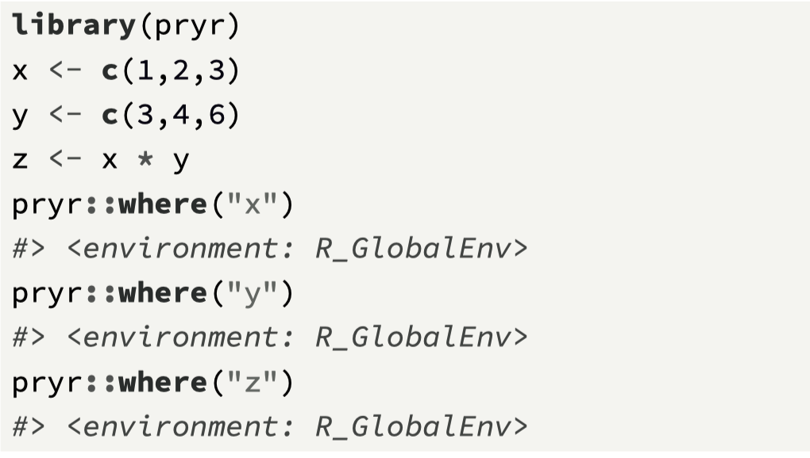
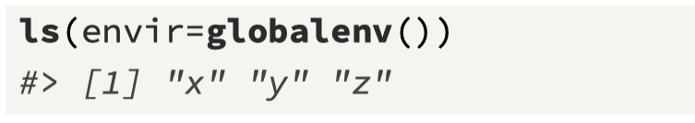
Environments and Functions
It is worth spending time on understanding an environment, which comprises two parts:
a frame that contains name-object bindings, and
a reference to its parent environment.
This reference mechanism creates a hierarchy of environments within R.
The global environment R_GlobalEnv, is the interactive workspace that contains user-defined variables and functions
The library pryr is useful to see where variables are.

Slide 16
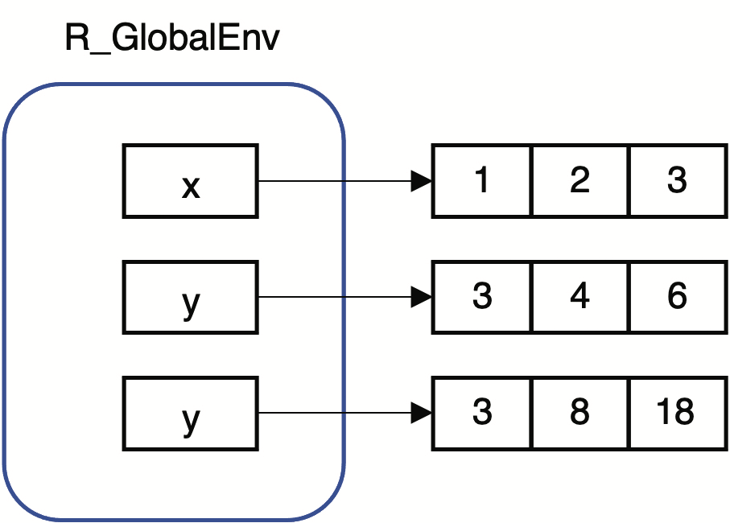
Visualising the environment
We can visualize an environment and its variables
The values of a variable are stored in memory, and for a vector, these are in successive (i.e., contiguous) locations.
We can visualize this storage as an array structure of three cells for each of the variables x, y, and z.
We also need a variable name (identifier) that references (or “points to”) the values in memory, and the link between the variable and its value in memory is known as a binding.
x, y, and z are part of the global environment

Slide 17
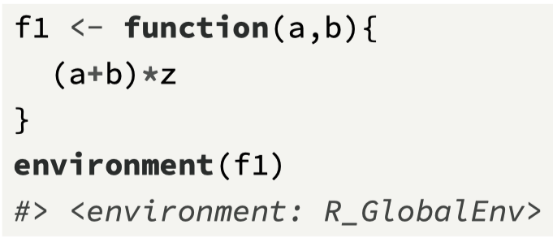
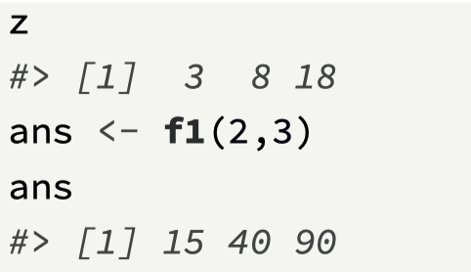
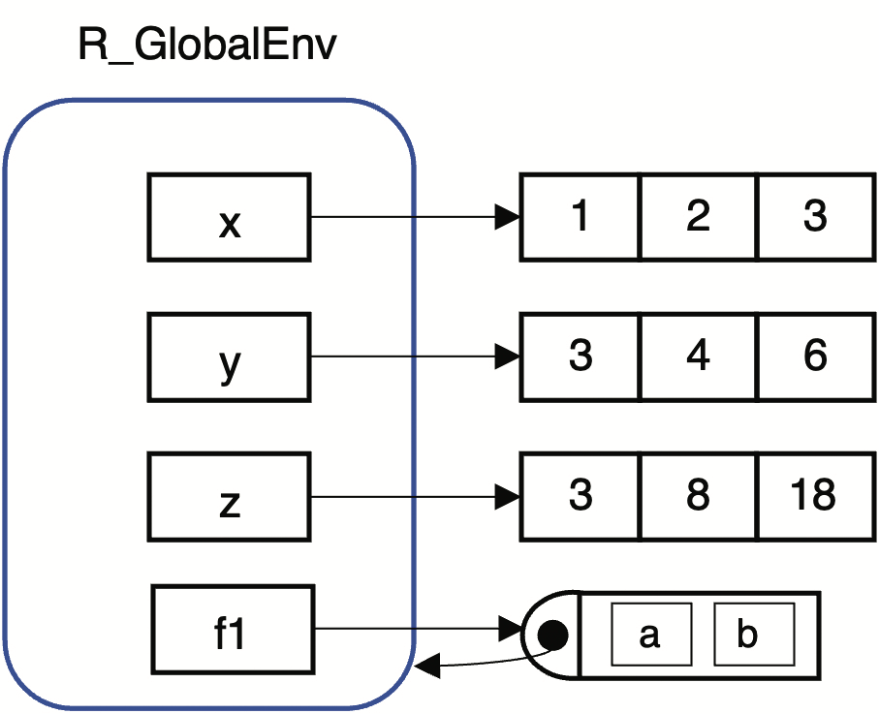
Adding a function…
Environments are also important for understanding how functions work.
When a function is created, it obtains a reference (i.e., it “points to”) the environment in which it was created, and this is known as the function’s enclosing environment.
The function environment() can be used to confirm a function’s enclosing environment
The function has access to all variables within its enclosing environment
Think about how the function f1 operates

Slide 18
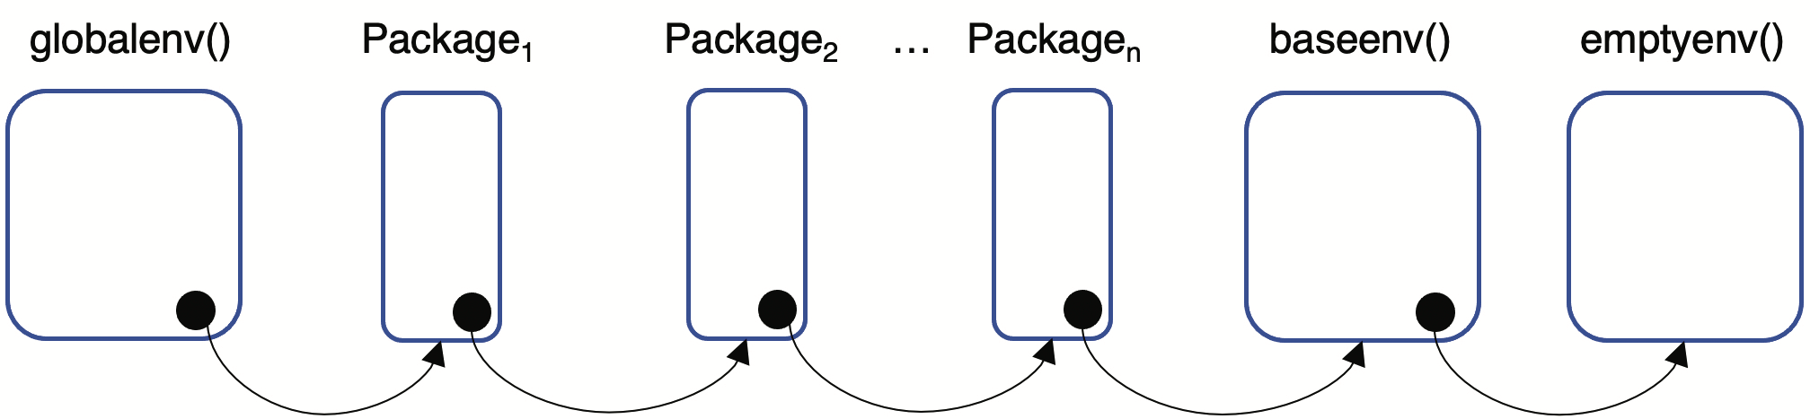
The overall R hierarchy
We now come to an important diagram in R, which clarifies the mechanisms by which R accesses variables.
Environments form a tree structure, in which every environment has a parent environment, apart from the environment at the top of the tree which is known as the empty environment
A separate environment is also added for each new package loaded using library(), and the newest package’s environment is added as the direct parent of the global environment

Slide 19
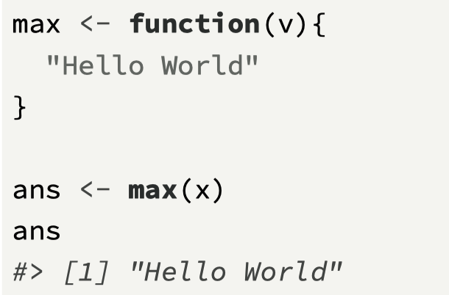
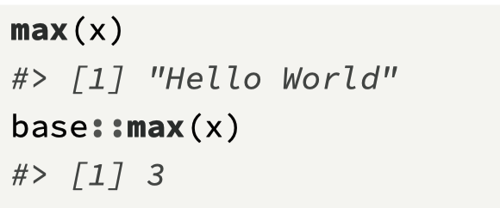
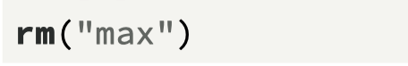
An example: using the package name ensures access
max()
max()

Slide 20
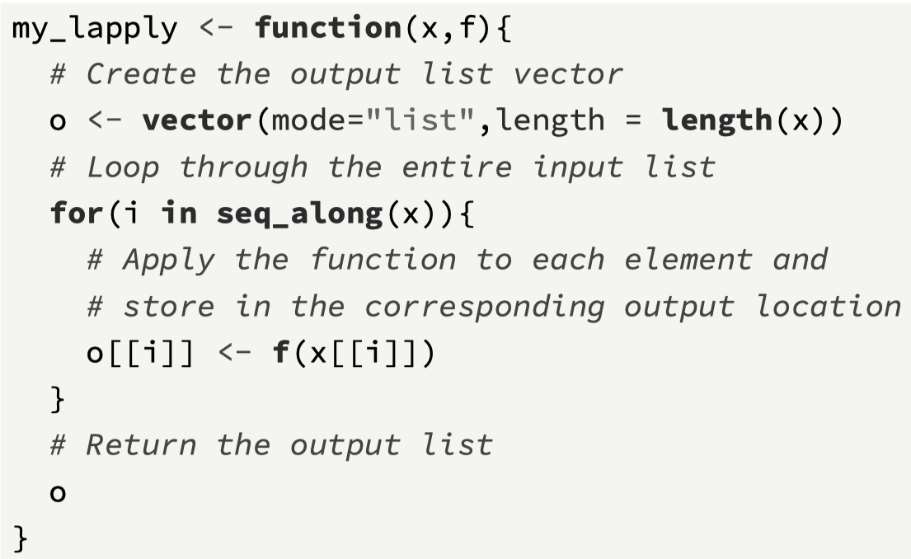
Functional using lapply() – overall idea
Functionals, which take functions as part of their input
In many cases, functionals can be used instead of loops to iterate over data and return a result, e.g. lapply(x, f)
Accepts as input a list x and a function f
Returns as output a new list where each element in the new list is the result of applying the function f to the corresponding element of the input list x

Slide 21
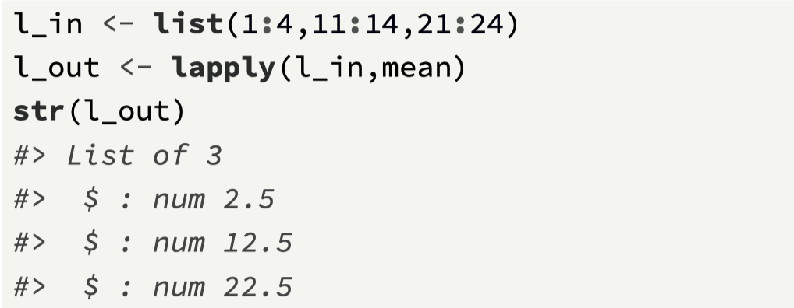
Using R’s lapply()

Slide 22
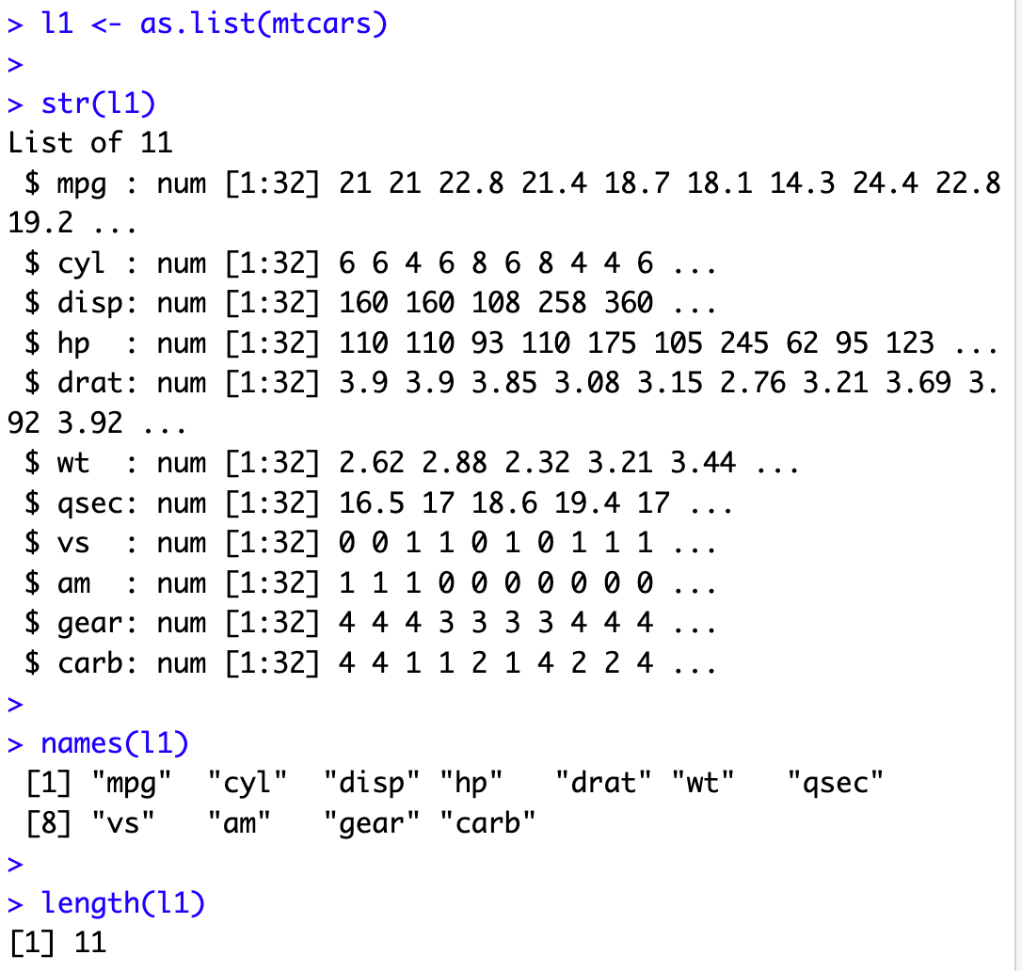
Challenge 4.2 – Use lapply()
Create a list from an R data structure (car information, mtcars)
Create an atomic vector to store 11 results
Process the list and store the mean for each of the list elements in the atomic vector.
Make sure that the names of the atomic vector elements match those in the list
Note the list is a form of “parallel arrays” each with 32 data points. Each index of the atomic vector relates to the same car.

Slide 23
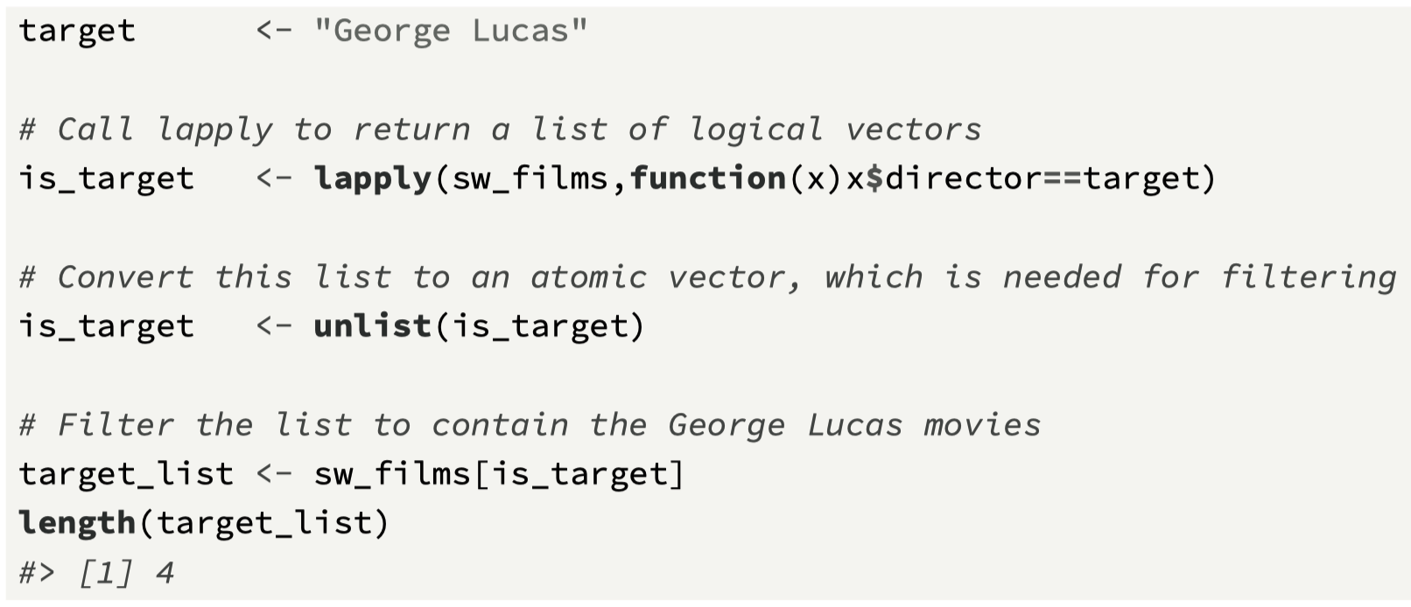
Star Wars Mini-Case - Revisted
Here we revisit the examples from Chapter 3, and the sole purpose of these code snippets is to demonstrate how the loop structures previously used can now be replaced by the function lapply().
Find movies directed by George Lucas

Slide 24
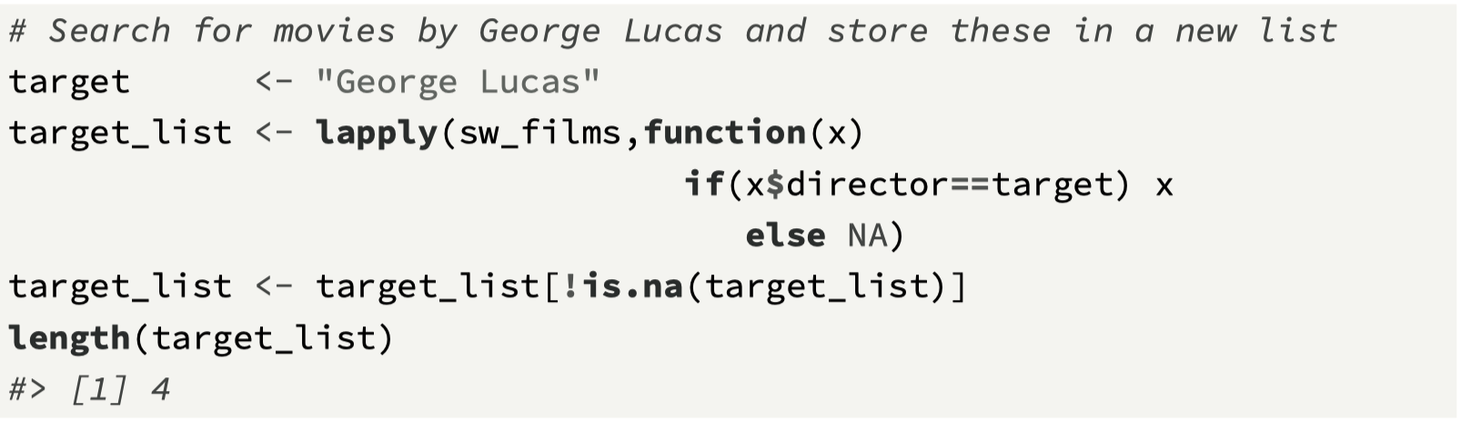
Alternative Solution – return actual element and post-process

Slide 25
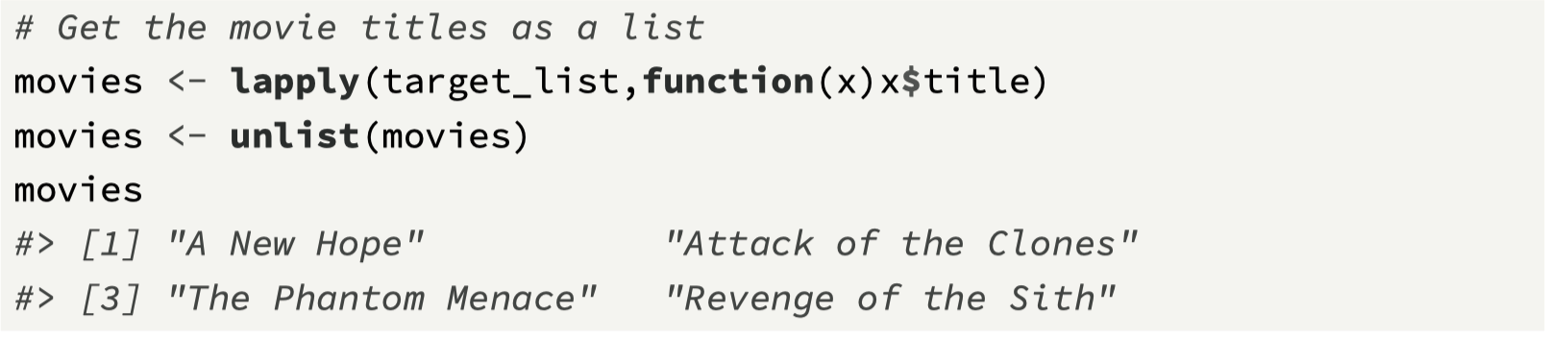
Get movie titles, and unlist()

Slide 26
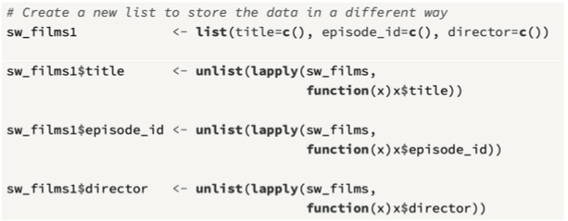
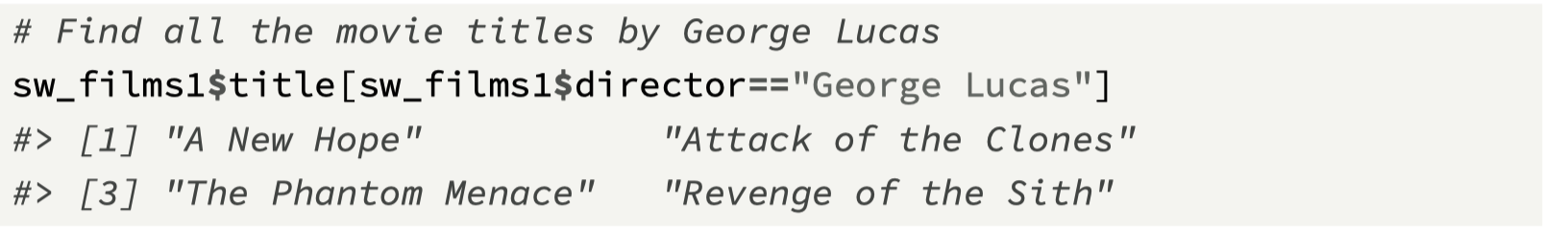
Restructure the list

Slide 27
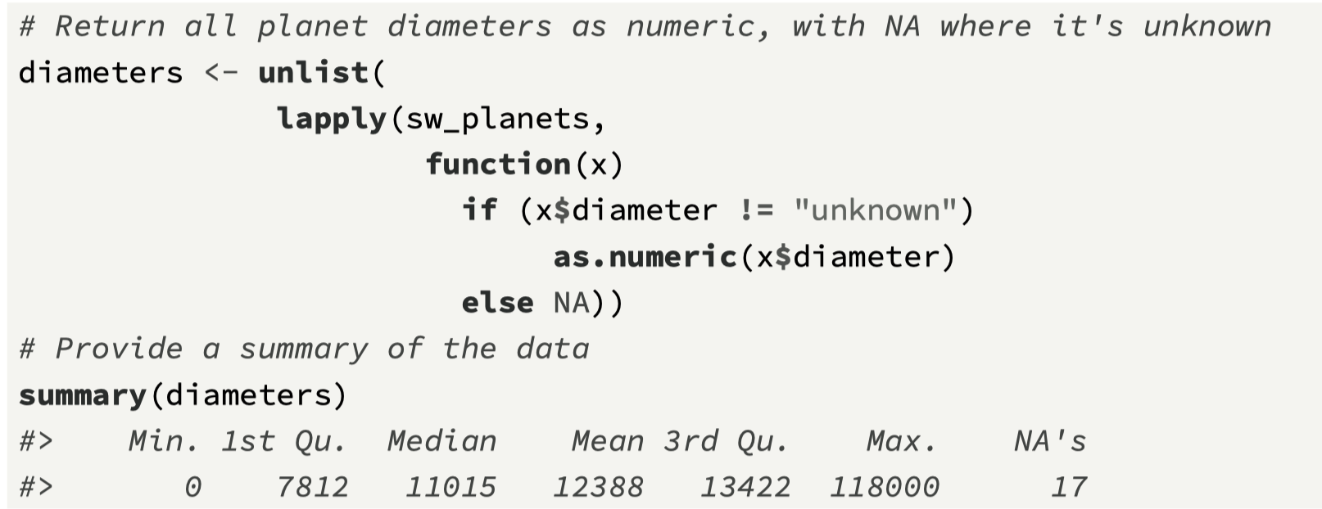
Extract all planet diameters

Slide 28
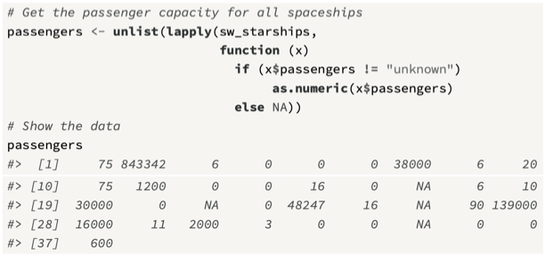
Get passenger capacity for spaceships

Slide 29
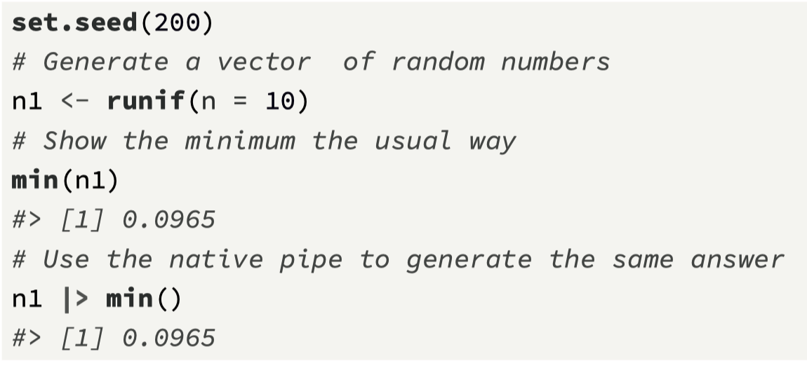
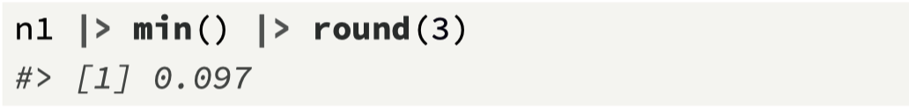
R’s Native Pipe Operator
The native pipe operator in R, represented by the symbol |>, allows you to chain a number of operations together, without having to assign intermediate variables.
This operator allows you to construct a data processing pipeline, where an input is identified (e.g., a list, vector, or later in the book, a data frame), an output specified, and each discrete step in generating the output is linked together in a chain
The general format of the pipe operator is LHS |> RHS, where LHS is the first argument of the function defined on the RHS.

Slide 30
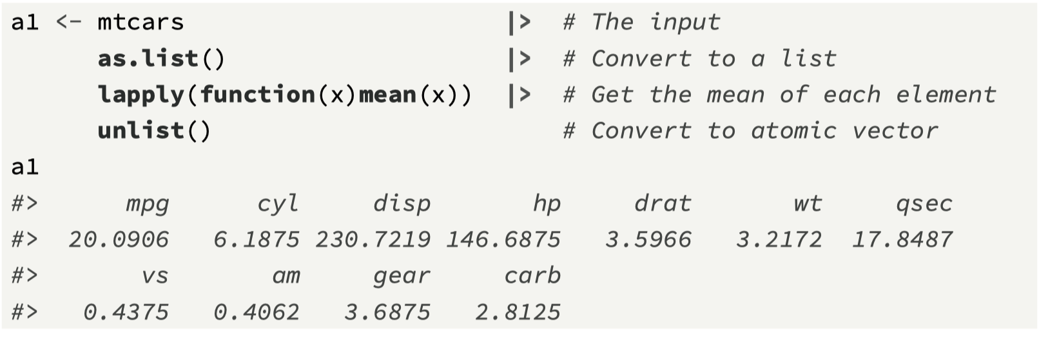
Starting with a data frame…

Slide 31
Chapter 4 Recap
Writing functions
Passing arguments and error checking
Environments and functions
Using lapply() as a way to process data with an anonymous function
Creating a data processing pipeline with |>
Next Challenge: a data processing pipeline
Next Topic: Matrices and Data Frames

Slide 32
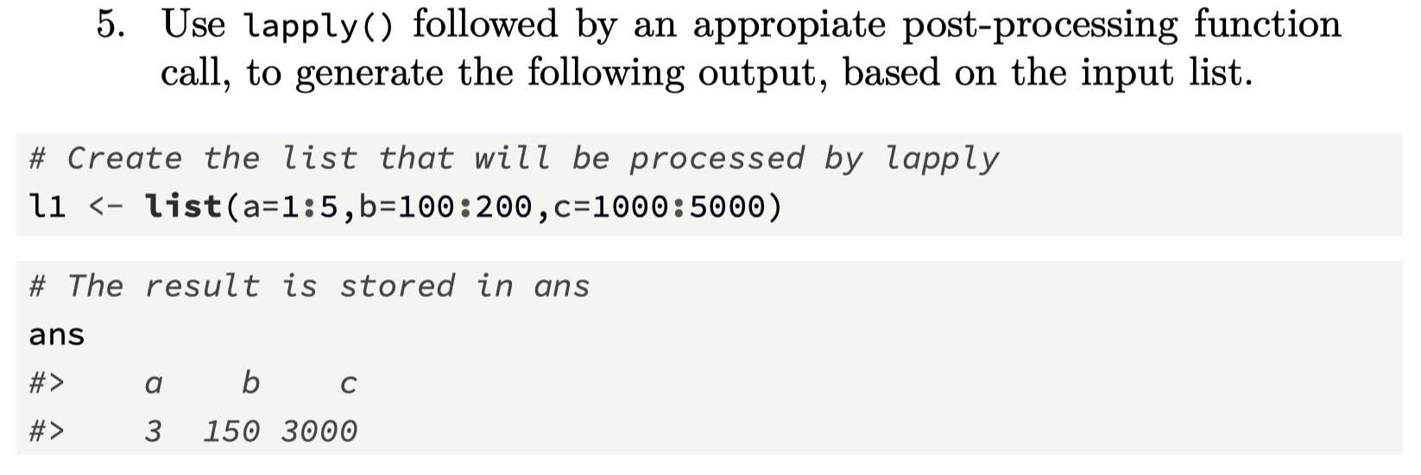
Challenge 4.3

